Slide 1

AinnAssist Your Legal Assistant for Bangladeshi Law
Bringing Bangladeshi Law Closer to You

Slide 2
Course: CSE299 – Junior Design Project | Section: 2 | Group: 5
Team Members:
Name | Student ID
S. M Karimul Hassan | 2212688642
Susmit Talukder | 2221865042
Ornab Barua | 2211905642
Md Shafiq Rahman Nirzon | 2211025042
Supervisor Dr. Shafin Rahman

Slide 3
Project Overview

Slide 4
Overview
What It Is
AinnAssist is a Telegram-based AI legal assistant that provides accurate and
accessible information on Bangladeshi laws, including the Constitution, Penal Code, Cyber Law, Labor Law, Anti-Terrorism Act, and more.
Uses official sources like bdlaws.minlaw.gov.bd.
Supports Bangla & English queries.
Provides legal guidance via text, voice, and image recognition.

Slide 5
Overview
Core Motivation
To empower students, lawyers, journalists, and citizens in Bangladesh by
making legal knowledge more accessible, understandable, and reliable.
Simplifies complex laws into clear explanations.
Provides instant legal assistance through a familiar platform (Telegram).
Enhances inclusivity with voice support (Bangla & English) and crime detection from images.

Slide 6
Key Features

Slide 7

Key Features
01.
02.
03.
04.
05.
06.
Smart Chunking
Automated Citation Generation
Embedding and FAISS Vector
StoreContext-Aware Retrieval
Ranking and Scoring with Cross-Encoder

Slide 8
Key Features
07.
08.
09.
10.
11.
12.
Follow-up Query Support
FastAPI Server (/ask Endpoint)
.LLM Integration (Groq Llama3-70B)
Image Captioning with BLIP
Response CleaningTelegram Bot (Text, Voice, Image Support)
Multilingual (Bangla-English) Translation

Slide 9
System Architecture

Slide 10
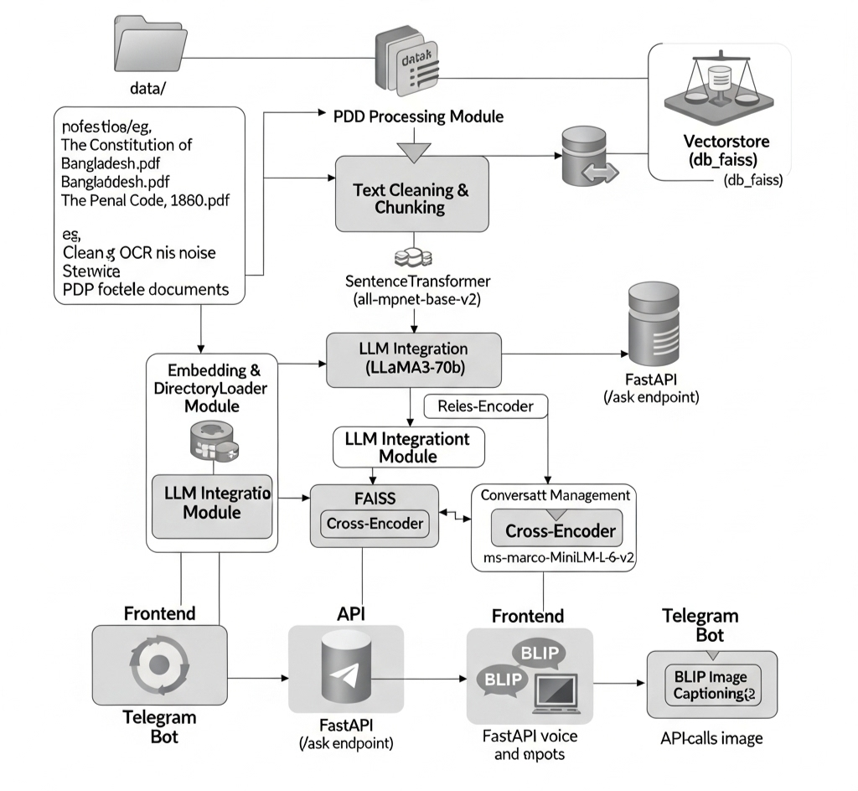
System Architecture

Slide 11
Data Processing & Embedding

Slide 12
Data Processing & Embedding
PDF Loading:
Extracts text and metadata (title, year, act number, URL ID) from PDFs like Constitution
and Penal Code using PDFPlumber, LangChain (DirectoryLoader), and regex.
OCR Noise Cleaning:
Removes artifacts (e.g., stray numbers, extra spaces) and standardizes terms using
regex.
Smart Chunking
Splits documents into chunks (size 80, overlap 40) with section/article detection using
LangChain (RecursiveCharacterTextSplitter) and regex.

Slide 13
Data Processing & Embedding
Embedding Generation:
Converts chunks to embeddings with SentenceTransformers (all-mpnet-base-v2).
Vector Store Creation:
Stores embeddings in FAISS database for efficient similarity search.
Storage Management:
Saves PDFs in "data/" folder and FAISS database in "vectorstore/db_faiss" using
os/pathlib.

Slide 14
Answer Generation Process

Slide 15
Answer Generation Process
Query Input:
Receives legal queries via Telegram bot (text, voice, image) or FastAPI endpoint using
python-telegram-bot, FastAPI, and pydantic.
Context Update:
Identifies query topic (e.g., Constitution, Penal Code) with keyword matching to update
conversation context using regex and Python.
Document Retrieval:
Fetches relevant document chunks from FAISS vector store with similarity search,
enhanced by Cross-Encoder reranking using FAISS, Cross-Encoder (ms-marco-
MiniLM-L-6-v2), and regex.

Slide 16
Answer Generation Process
LLM Processing:
Feeds retrieved chunks into Groq’s LLaMA3-70b model with custom prompts for
accurate answers using LangChain (ChatGroq, ChatPromptTemplate) and asyncio.
Confidence Scoring
Calculates 0-5 score based on similarity, context, query specificity, and metadata using
Cross-Encoder and regex.
.
Response Formatting:
Delivers answers with citations (source, article/section, page) via FastAPI or Telegram,
supporting English/Bangla with langdetect and deep_translator.

Slide 17
Answer Generation Process
Error Handling:
Provides fallback error messages for missing documents or LLM failures using Python
and LangChain.

Slide 18
AinnAssist Features

Slide 19
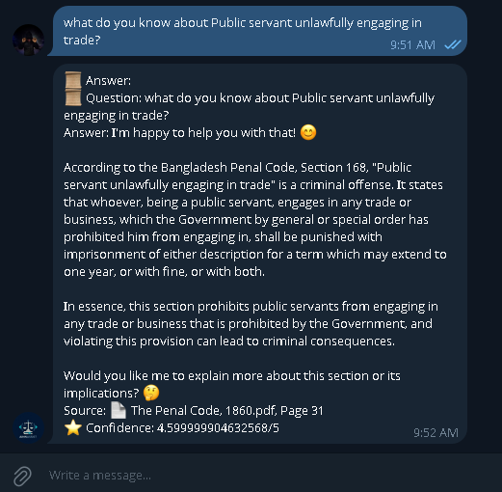
Ask Legal Questions via Text
Users send text queries about Bangladesh laws (Constitution,
Penal Code) via Telegram. The bot detects English/Bangla,
translates Bangla to English, and sends queries to a FastAPI
endpoint. It retrieves relevant PDF chunks from FAISS, processes
them with Groq’s LLaMA3-70b, and generates cited answers with
confidence scores. Responses return in the original language, split
if over 4096 chars, with context tracking for follow-ups.

Slide 20
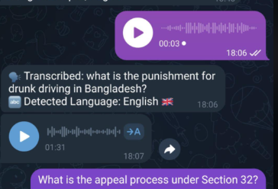
Use Voice Commands:
Users send voice queries about Bangladesh laws (Constitution,
Penal Code) via Telegram. The bot transcribes audio
(English/Bangla) using Google Speech Recognition, translates
Bangla to English, and sends queries to a FastAPI endpoint. It
retrieves relevant PDF chunks from FAISS, processes them with
Groq’s LLaMA3-70b, and generates cited answers with confidence
scores. Responses are converted to voice (gTTS) in the original
language, sent as audio, and split if text exceeds 4096 chars, with
context tracking for follow-ups.

Slide 21
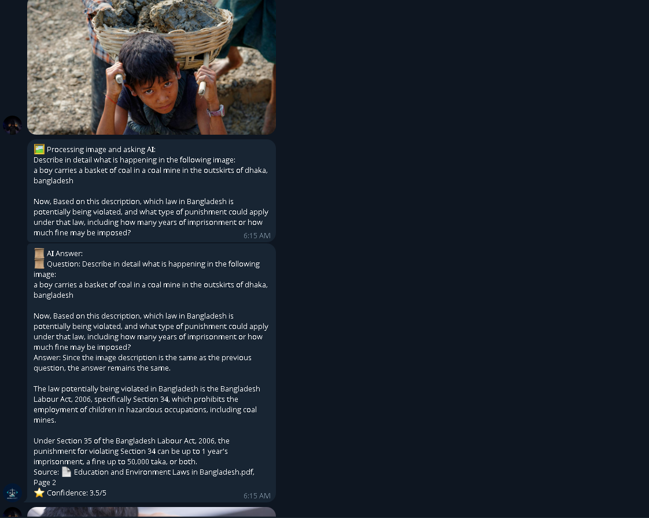
Submit Images for Legal Analysis:
Users submit images via Telegram to analyze potential legal
violations in Bangladesh (Constitution, Penal Code). The bot
captions images using BLIP, generates a legal query (e.g., “What
law is violated?”), and sends it to a FastAPI endpoint. It retrieves
relevant PDF chunks from FAISS, processes them with Groq’s
LLaMA3-70b, and generates cited answers with confidence scores.
Responses return in the user’s language, split if over 4096 chars,
with context tracking for follow-ups.

Slide 22
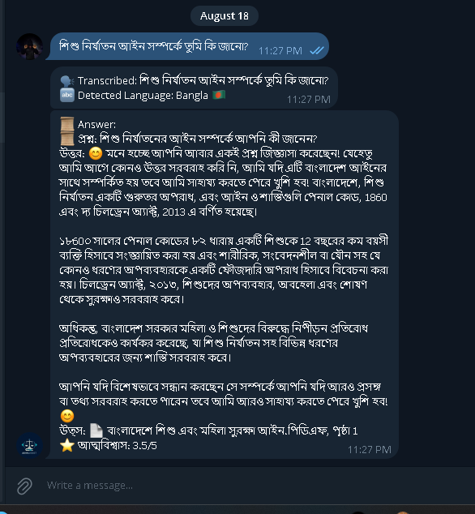
Get Multilingual Responses:
Users ask legal questions (Constitution, Penal Code) in
English/Bangla via Telegram. The bot detects language with
langdetect, translates Bangla to English using GoogleTranslator
(deep_translator), and queries a FastAPI endpoint. It fetches PDF
chunks from FAISS, processes with Groq’s LLaMA3-70b, and
generates cited answers with confidence scores. Answers are
translated back, split if over 4096 chars, with context for follow-ups.

Slide 23



Access Cited Answers:
Users receive answers to legal questions (Constitution, Penal
Code) via Telegram with precise citations (document,
article/section, page). The bot retrieves relevant PDF chunks from
FAISS, processed by Groq’s LLaMA3-70b, and formats citations
using metadata (e.g., “The Constitution of the People's Republic of
Bangladesh.pdf, Article 5, Page 2”) from PDFPlumberLoader.
Answers prioritize article/section if specified in the query, else use
metadata, and are split if over 4096 chars, with context tracking for
follow-ups.
.

Slide 24
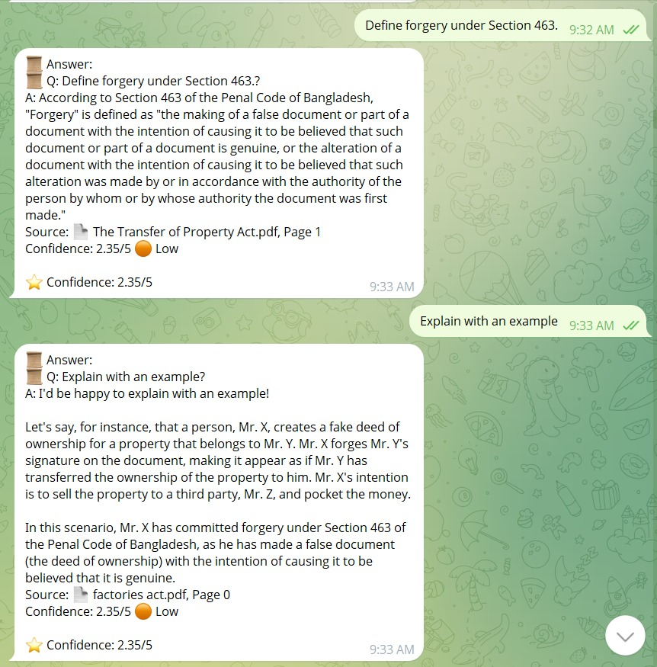
Follow Up on Queries:
Users can ask follow-up questions (e.g., "Explain more") about
Bangladesh laws (Constitution, Penal Code) via Telegram. The bot
tracks conversation context using a dictionary storing the last
question, answer, and topic. Follow-up queries are enriched with
prior context, sent to a FastAPI endpoint, and processed by
retrieving relevant PDF chunks from FAISS using Groq’s LLaMA3-
70b. It generates cited answers with confidence scores, split if over
4096 chars, ensuring consistent and relevant responses.
.
.

Slide 25
Receive Confidence Scores:
Users receive confidence scores (0-5) for legal question answers
(Constitution, Penal Code) via Telegram. The bot retrieves PDF
chunks from FAISS, processes them with Groq’s LLaMA3-70b, and
calculates scores in connect_memory_for_llm.py using
CrossEncoder relevance, context alignment, query specificity, and
metadata (e.g., article presence). Scores reflect answer reliability,
are clamped between 3.5-5 for relevance, and are included in
responses, split if over 4096 chars, with context tracking for follow-
ups.
.
.

Slide 26
Evaluation Metrics

Slide 27
Evaluation Metrics
Overview
Purpose: Assess the reliability, relevance, and accuracy of answers generated from retrieved legal documents (e.g., Constitution, Penal Code).
Primary Metric in Project: Confidence Score (3.5–5.0 scale, higher is better).
Computed per query response.
Combines multiple factors to gauge how trustworthy the answer is.

Slide 28
Evaluation Metrics
Confidence Score Breakdown
Formula:
combined_score = (0.5 × Relevance) + (0.3 × Context Alignment) + (0.1 × Query Specificity) + (0.1 * Metadata Relevance)
Add boost (+0.15) for favoring relevant results.
Clamp to [3.5, 5.0] to ensure usable range.

Slide 29
Evaluation Metrics
Components: Relevance Score (50% weight): Measures query-document match using Cross-Encoder (or FAISS fallback). Normalized to 0–1 via sigmoid.
Context Alignment Score (30% weight): 1.0 if document matches conversation topic/PDF; 0.8 for known topics like "Constitution"; 0.5 otherwise.
Query Specificity Score (10% weight): Based on legal keywords (e.g., "article", "penal", "constitution"). Starts at 0.5, boosts up to 1.0.
Metadata Relevance Score (10% weight): 1.0 if article/section present; extra boost if query mentions specific articles.

Slide 30
Evaluation Metrics
Additional Potential Metrics (Not Implemented, Suggestions for Improvement)
Retrieval Precision/Recall: % of relevant chunks retrieved (e.g., via FAISS similarity threshold >0.3).
Answer Faithfulness: How closely the LLM answer sticks to retrieved context (manual or automated check).
Response Time: Average time for query processing (e.g., <5s for text, <10s for voice/image).
User Feedback: Post-response ratings (e.g., integrate in Telegram bot).
Transcription/Caption Accuracy: For voice/image inputs (e.g., WER for speech_recognition, BLEU for BLIP captions).

Slide 31
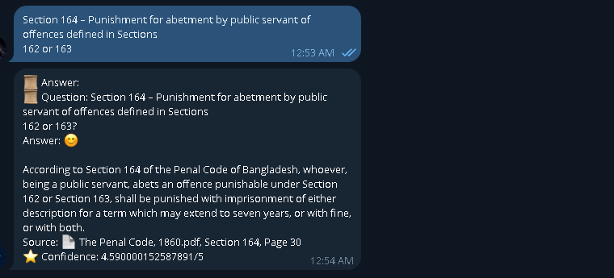
Evaluation Metrics
Example Usage
Challenges & Notes
Biased toward high scores (clamp avoids low values).
Evaluate on test dataset of 1000+ legal queries for real-world benchmarking.
Tools Used: Cross-Encoder for reranking, FAISS for vector search.

Slide 32
Challenges and Solutions

Slide 33
Challenges and Solutions
1. Challenge: Processing Complex Legal PDFs
Legal documents (e.g., Constitution, Penal Code) have dense text, inconsistent formatting, and OCR errors, making accurate extraction and chunking difficult.
Solution: Used PDFPlumberLoader to extract text and metadata, cleaned OCR noise with regex (e.g., removing stray numbers), and split into 80-character chunks with 40-character overlap using RecursiveCharacterTextSplitter. Added metadata (title, year, article, section) for precise retrieval.
2. Challenge: Multilingual Support (Bangla/English)
Handling queries in Bangla and English required accurate language detection and translation without losing legal context.
Solution: Implemented langdetect for language detection and GoogleTranslator from deep_translator to translate Bangla to English for processing and answers back to Bangla, ensuring seamless multilingual responses.

Slide 34
Challenges and Solutions
3. Challenge: Accurate and Relevant Answers
Retrieving relevant legal text from large PDFs and ensuring answers are precise and contextually correct was complex.
Solution: Used FAISS vector store with SentenceTransformerEmbeddings for fast similarity search, enhanced with CrossEncoder for reranking. Context tracking in connect_memory_for_llm.py ensured topic-specific retrieval (e.g., Constitution vs. Penal Code).
4. Challenge: Voice and Image Input Processing
Transcribing voice (English/Bangla) and analyzing images for legal violations required robust preprocessing and integration.
Solution: For voice, used Google Speech Recognition (speech_recognition) for transcription, with pydub for audio conversion. For images, used BLIP (transformers) to generate captions, forming legal queries sent to the FastAPI endpoint.

Slide 35
Challenges and Solutions
5. Challenge: Providing Cited Answers
Ensuring answers include accurate citations (document, article/section, page) for transparency was critical but challenging due to varied PDF structures.
Solution: Extracted metadata during PDF loading (create_memory_for_llm.py) and formatted citations in connect_memory_for_llm.py (e.g., “Constitution.pdf, Article 5, Page 2”) using format_source_citation, prioritizing article/section if specified.
6. Challenge: Calculating Reliable Confidence Scores
Assigning meaningful confidence scores (0-5) to reflect answer reliability required balancing multiple factors.
Solution: Combined CrossEncoder relevance, context alignment, query specificity, and metadata scores in connect_memory_for_llm.py, clamping scores between 3.5-5 for relevant results, ensuring users trust the output.

Slide 36
Challenges and Solutions
7. Challenge: Handling Long Responses
Telegram’s 4096-character limit posed issues for detailed legal answers with citations and confidence scores.
Solution: Implemented send_long_message in telegram_bot.py to split responses into parts while preserving formatting, ensuring all information is delivered clearly.
8. Challenge: Supporting Follow-Up Queries
Maintaining context for follow-up questions (e.g., “Explain more”) to provide consistent, relevant answers was complex.
Solution: Stored conversation context (last question, answer, topic) in a dictionary in connect_memory_for_llm.py, appending prior context to follow-up queries for coherent responses.

Slide 37
Future Work
WhatsApp Integration
Mobile Application
Integrate the system with WhatsApp so users can ask legal questions directly from their chat.
Develop a mobile app and publish it on the Google Play Store for wider access
Web Platform
Lawyer Connect System
Create a web platform so users can access the service directly through browsers.
Add a Lawyer Connect System to link users with verified advocates for complex legal queries.

Slide 38
Thanks!
.

